Slide 1
Cromwell & Nextflow File Operations Comparison using Mistral on GATK HaplotypeCaller Workflow
Ashwini Chhipa
ISG, Wellcome Sanger Institute

Slide 2
Experimental Setup
GitHub Repository:
https://github.com/wtsi-ssg/mistral_benchmarking_cromwell_nextflow
GATK Tool:
GATK Version: 4.1.4.1 (https://software.broadinstitute.org/gatk/download/)
HaplotyperCaller
System:
Ubuntu 18.04.2 LTS
OpenStack instance: m1.xlarge (avx support)
Memory: 134.4 GB, Cores: 16, Disk: 250GB
Input File:
HG00101_align.bam (79G)
Reference File: hs38DH.fa
Java: OpenJDK-1.8.0_232
Singularity: v3.4.2-1 (https://sylabs.io/guides/3.0/user-guide/installation.html)
Cromwell:
Jar: cromwell-47.jar (https://github.com/broadinstitute/cromwell/releases/tag/47)
Nextflow:
v19.10.0_b5170 (https://www.nextflow.io/docs/latest/getstarted.html)
Mistral:
v2.13.4_RC5_x86_64
Singularity Container Image: gatk.img (v4.1.2.0) (https://ac55bkt2.cog.sanger.ac.uk/public/gatk.img)

Slide 3
Continue…
There were 5 runs given on 5 different m1.xlarge OpenStack hosts
Input files were copied to local disk of each host
Details of 5 runs:
Node 1:
Nextflow with Singularity Container running GATK
Node 2:
Cromwell with Singularity Container running GATK
Node 3:
Nextflow running GATK natively
Node 4:
Cromwell running GATK natively
Node 5:
GATK running natively
Output File:
HG00101.raw.indels.snps.vcf (995MB)
HG00101.raw.indels.snps.vcf.idx (12MB) (index file)

Slide 4
Time Measure
Run type | Time taken (HaplotypeCaller VCF)
Cromwell with Singularity | 1458.19 minutes (~24.30 hours)
Nextflow with Singularity | 1560.49 minutes (~26.01 hours)
Cromwell without Singularity | 1705.92 minutes (~28.43 hours)
Nextflow without Singularity | 1546.12 minutes (~25.76 hours)
GATK Natively | 1771.6 minutes (~29.53 hours)

Slide 5
Containerized Workflows
(For VCF only)

Slide 6
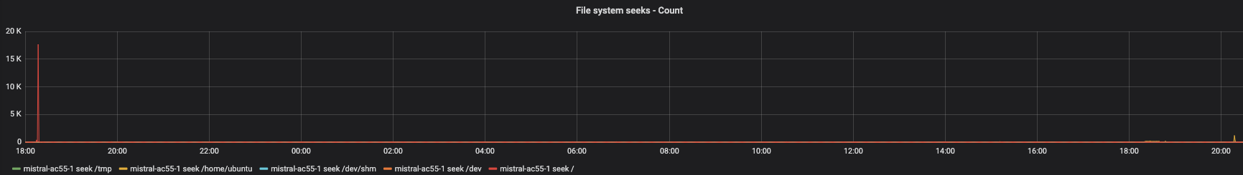
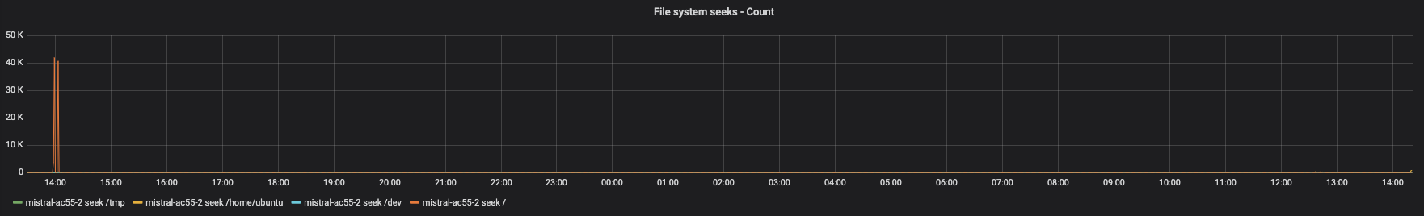
File System Seeks – Count
Nextflow
Cromwell

Slide 7
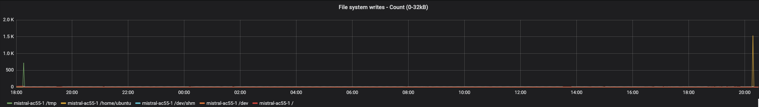
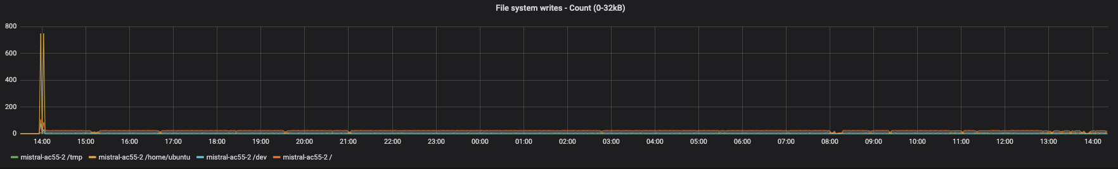
File System Writes – Count (0-32kB)
Nextflow
Cromwell

Slide 8
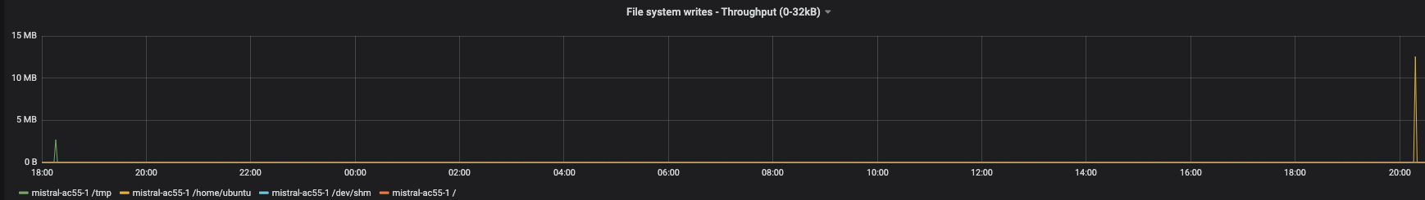
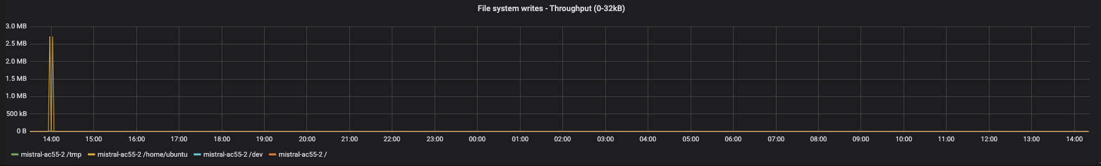
File System Writes – Throughput (0-32kB)
Nextflow
Cromwell

Slide 9
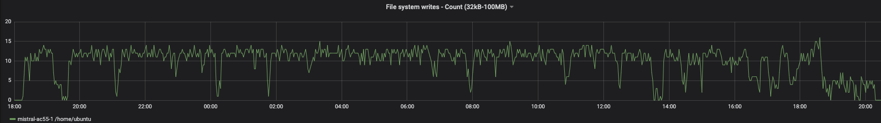
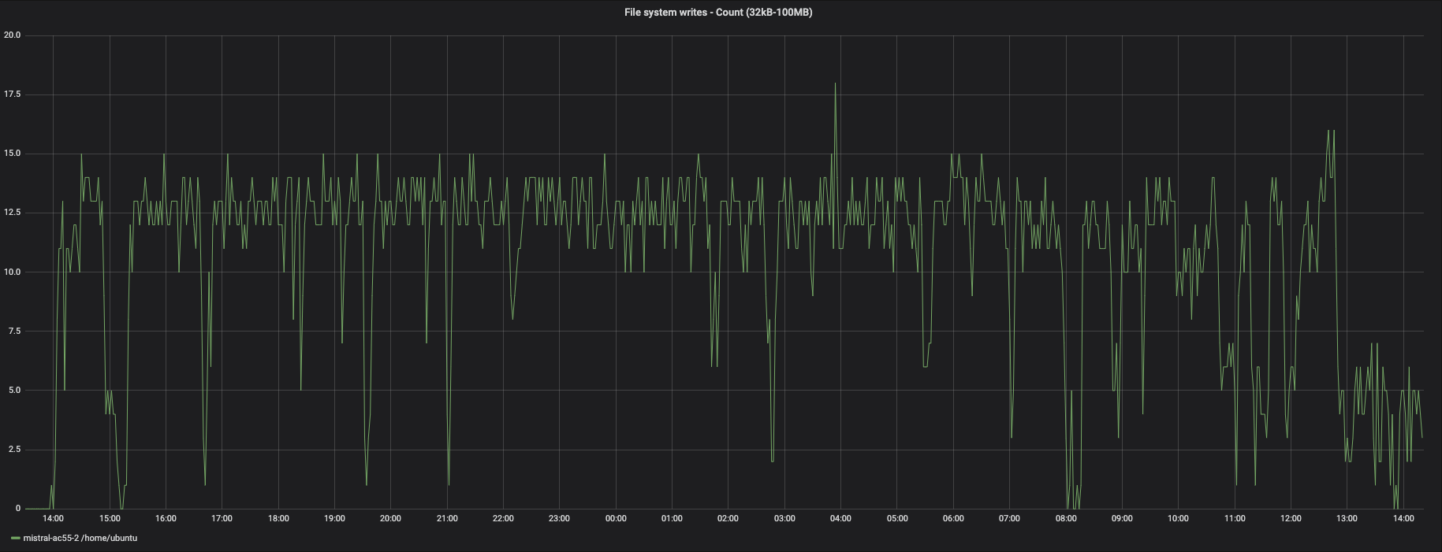
File System Writes – Count (32kB-100MB)
Nextflow
Cromwell

Slide 10
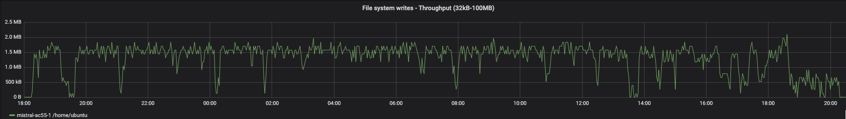
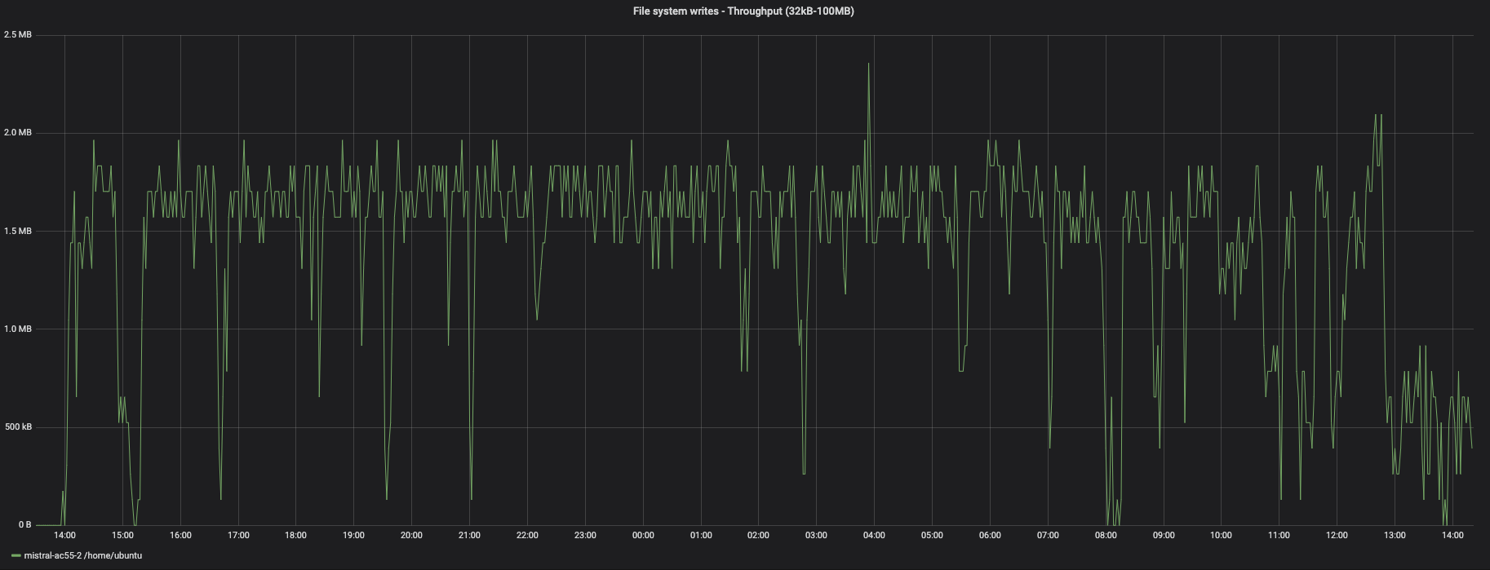
File System Writes – Throughput (32kB-100MB)
Nextflow
Cromwell

Slide 11
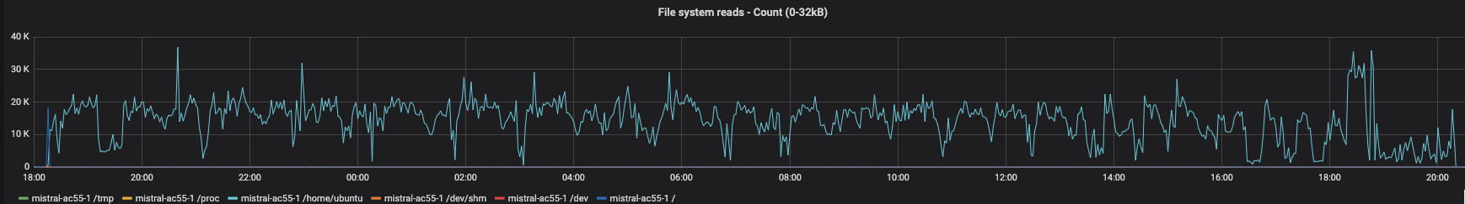
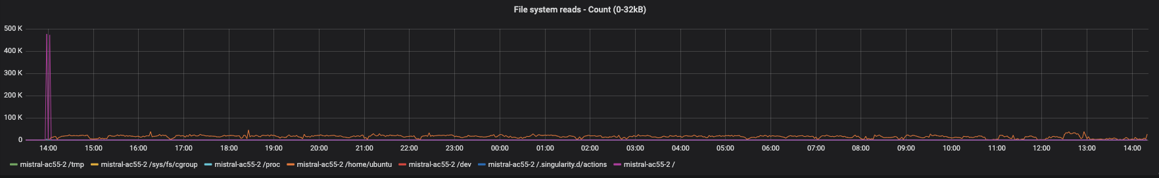
File System Reads – Count (0-32kB)
Nextflow
Cromwell

Slide 12
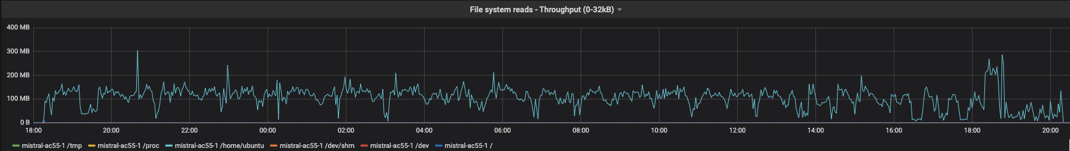
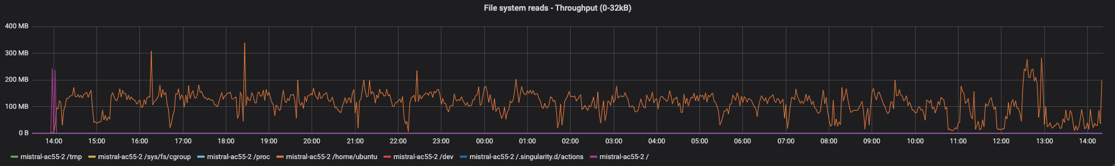
File System Reads – Throughput (0-32kB)
Nextflow
Cromwell

Slide 13
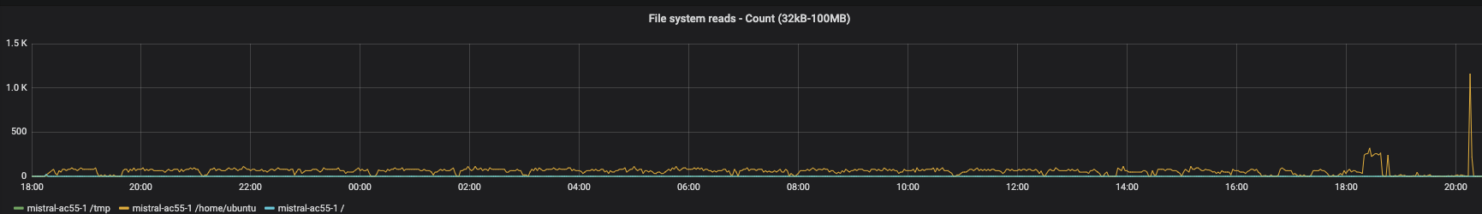
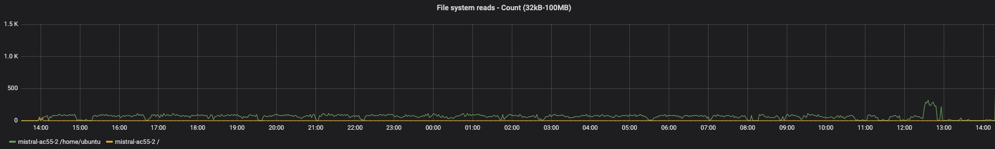
File System Reads – Count (32kB-100MB)
Nextflow
Cromwell

Slide 14
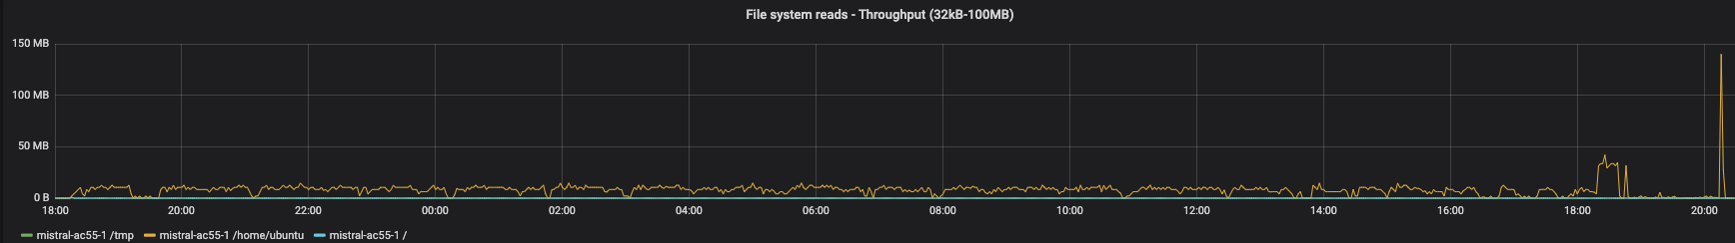
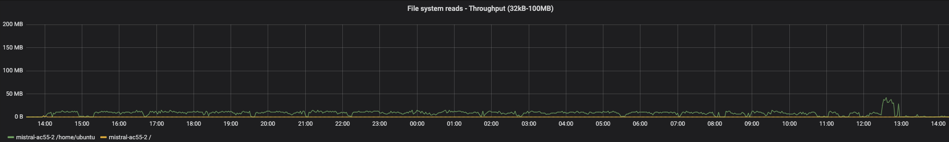
File System Reads – Throughput (32kB-100MB)
Nextflow
Cromwell

Slide 15
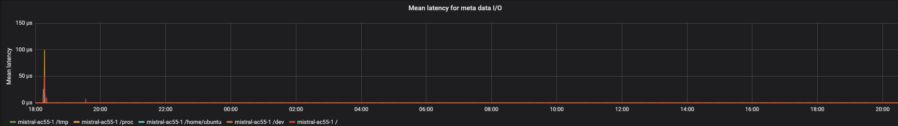
Mean Latency for meta data I/O
Nextflow

Slide 16
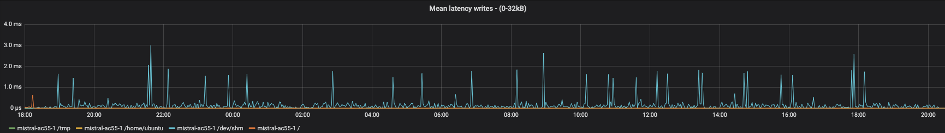
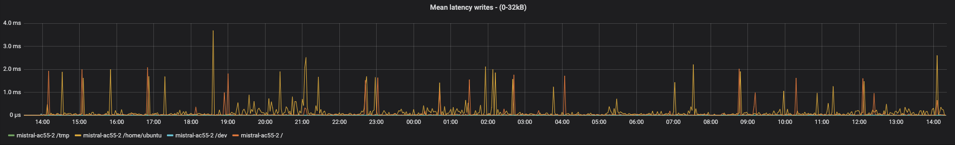
Mean Latency Writes– (0-32kB)
Nextflow
Cromwell

Slide 17
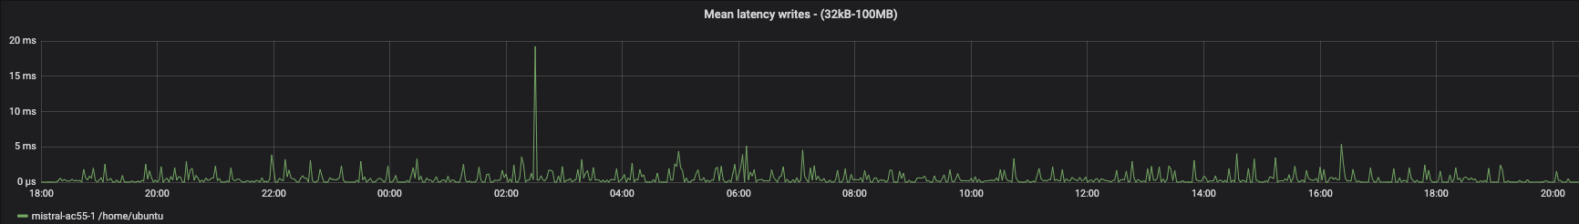
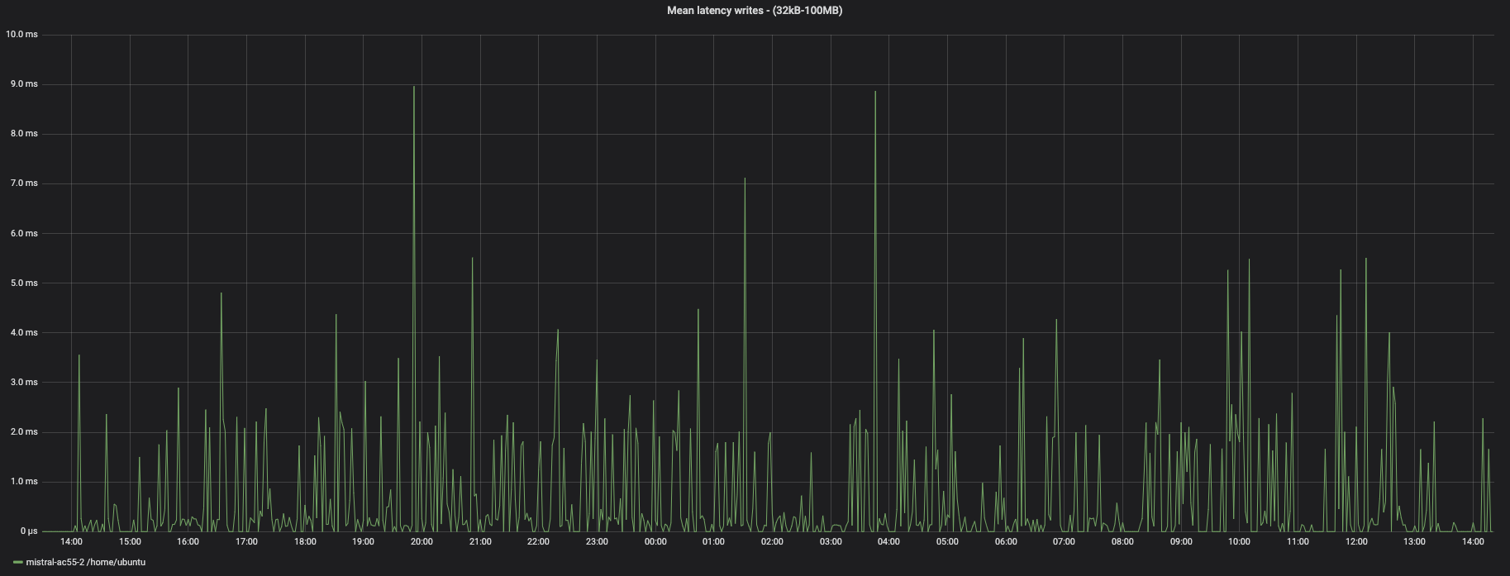
Mean Latency Writes– (32kB-100MB)
Nextflow
Cromwell

Slide 18
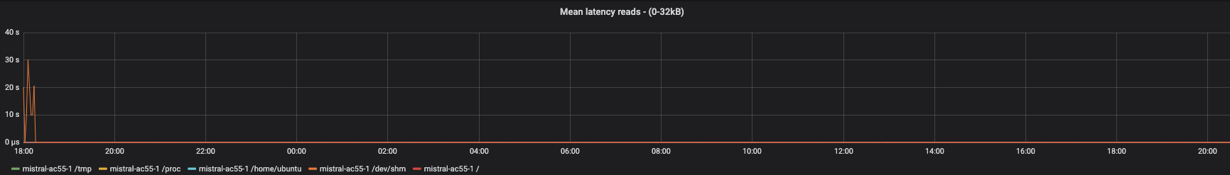
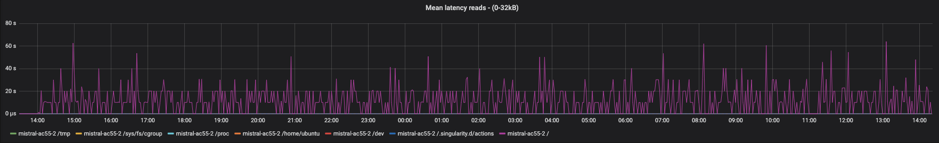
Mean Latency Reads– (0-32kB)
Nextflow
Cromwell

Slide 19
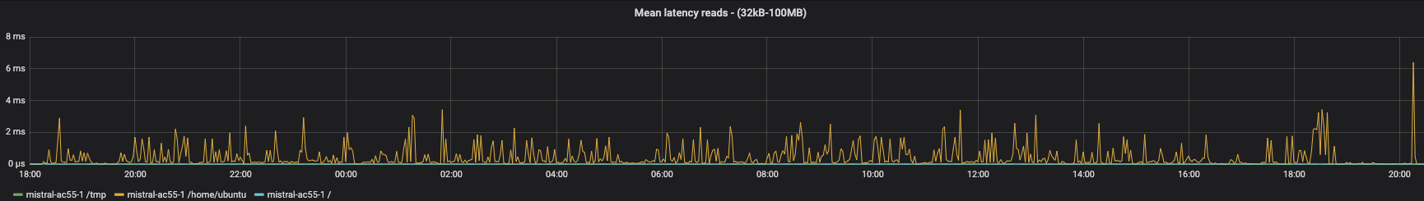
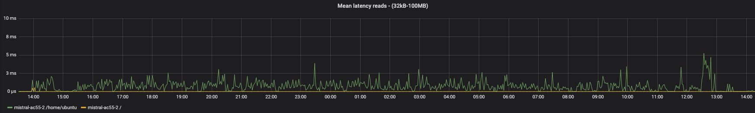
Mean Latency Reads– (32kB-100MB)
Nextflow
Cromwell

Slide 20
Non-Containerized Workflows
(For VCF only)

Slide 21
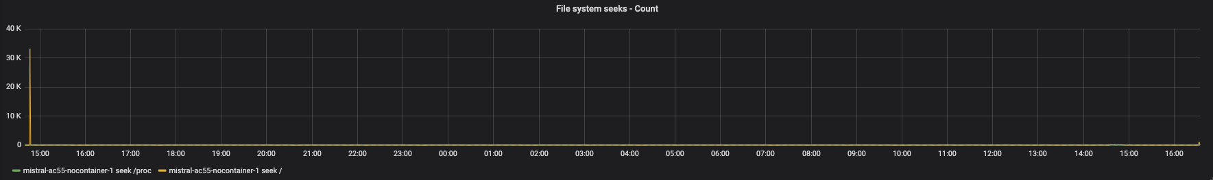
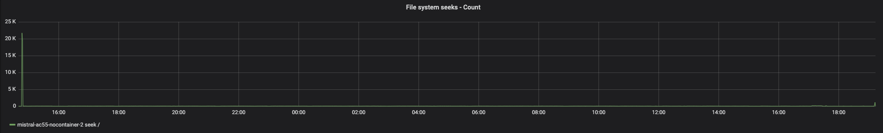
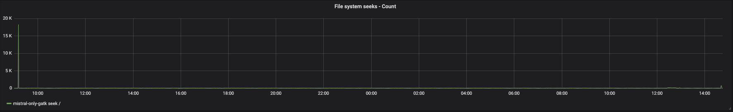
File System Seeks – Count
Nextflow
Cromwell
Native GATK

Slide 22
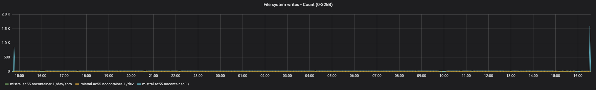
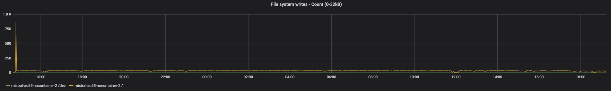
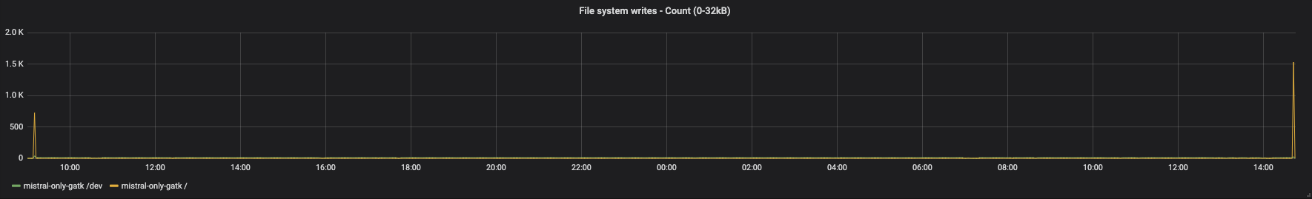
File System Writes – Count (0-32kB)
Nextflow
Cromwell
Native GATK

Slide 23
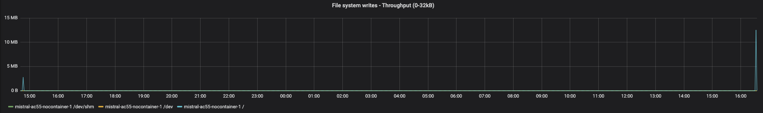
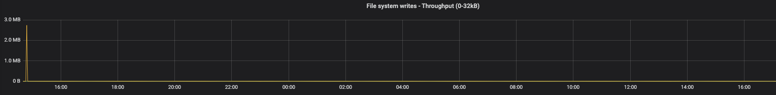
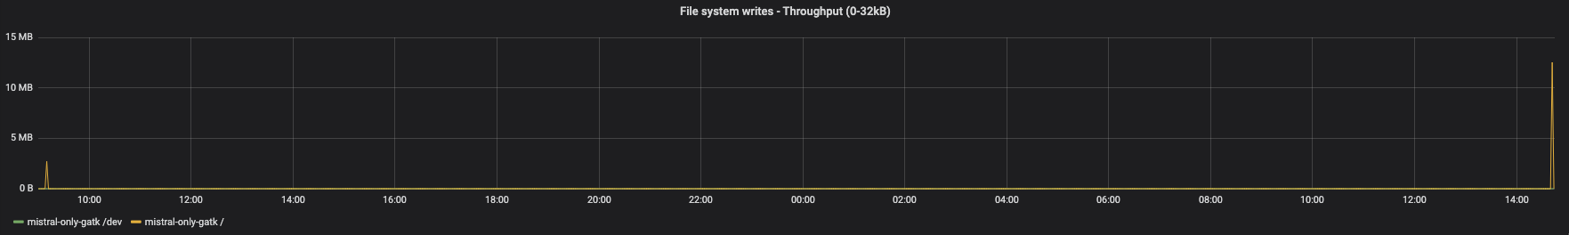
File System Writes – Throughput (0-32kB)
Nextflow
Cromwell
Native GATK

Slide 24
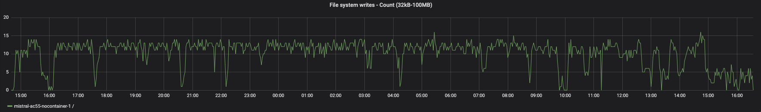
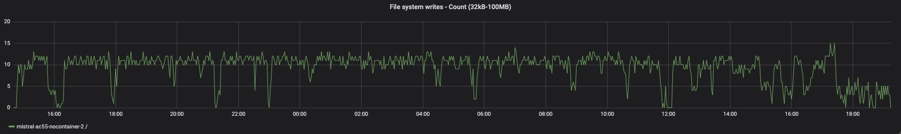
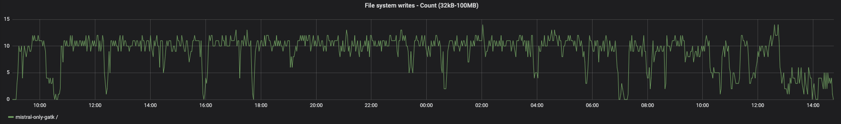
File System Writes – Count (32kB-100MB)
Nextflow
Cromwell
Native GATK

Slide 25
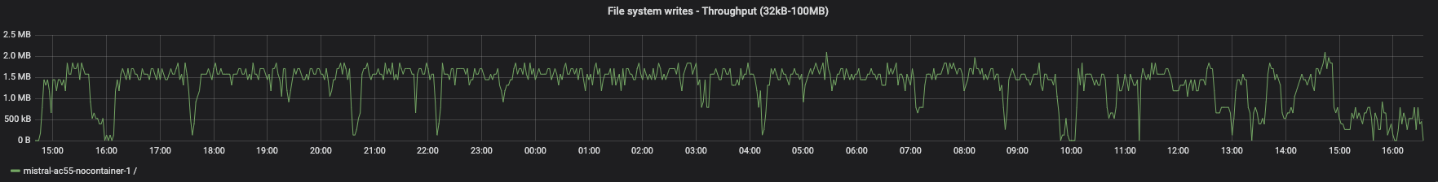
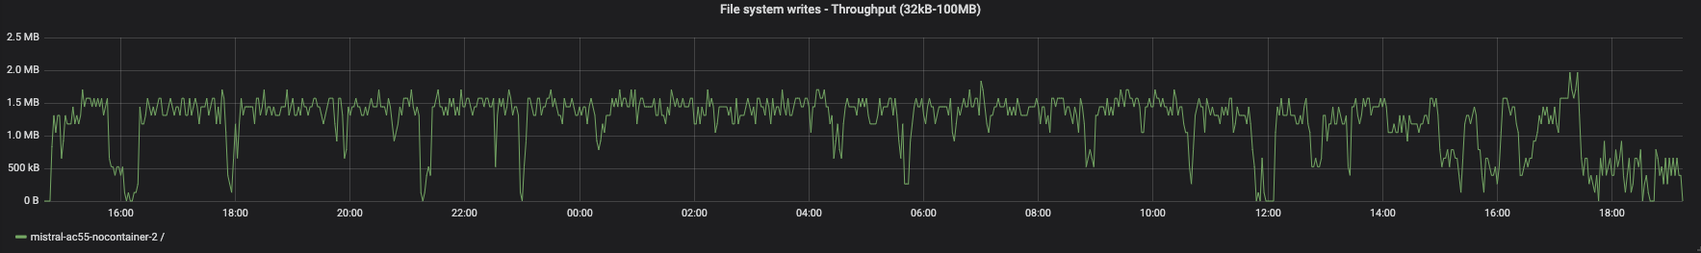
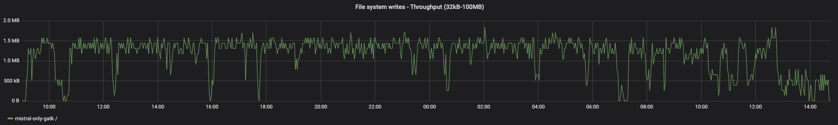
File System Writes – Throughput (32kB-100MB)
Nextflow
Cromwell
Native GATK

Slide 26
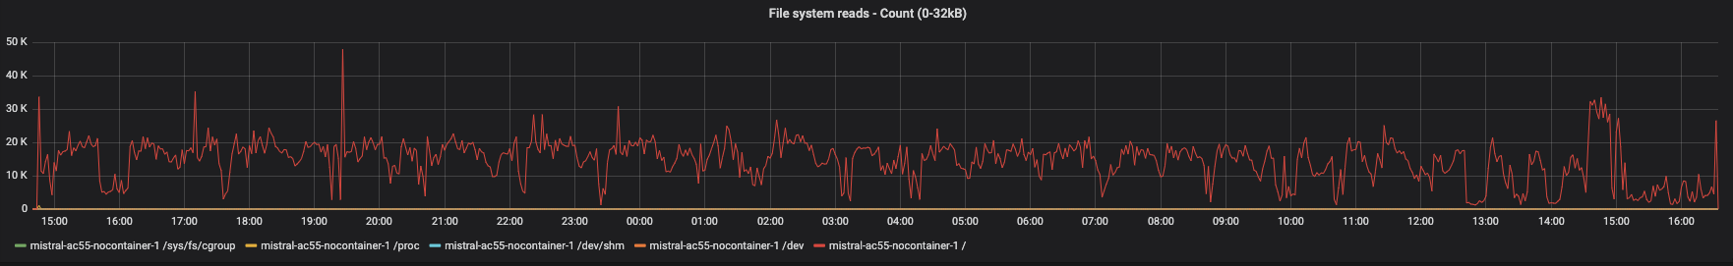
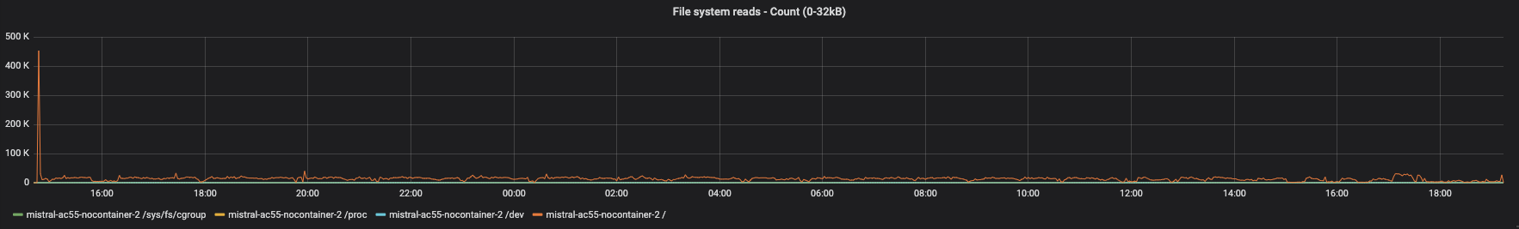
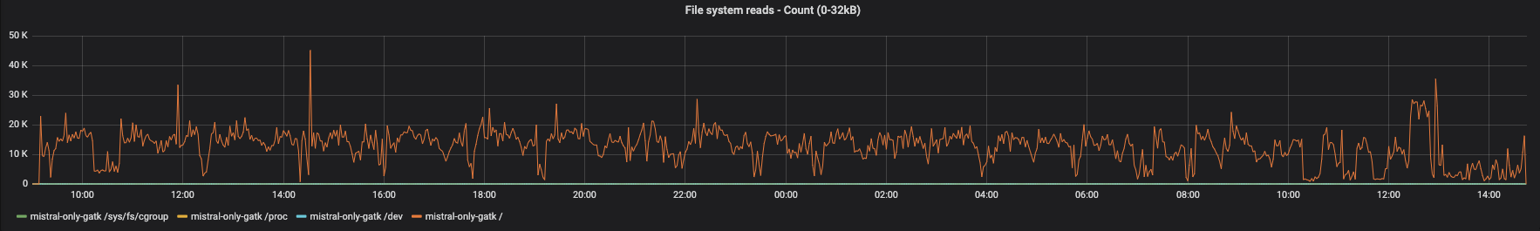
File System Reads – Count (0-32kB)
Nextflow
Cromwell
Native GATK

Slide 27
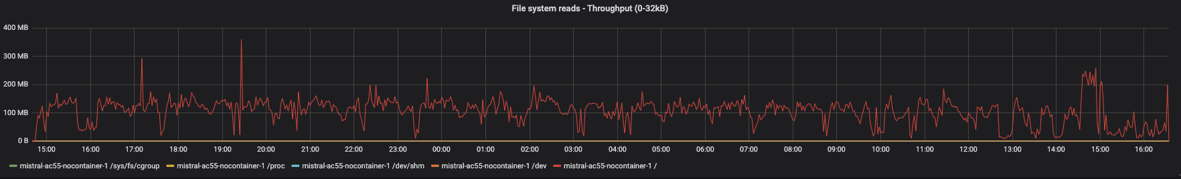
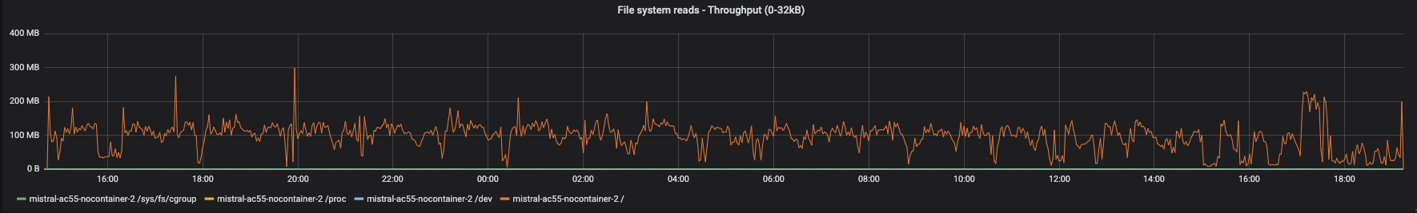
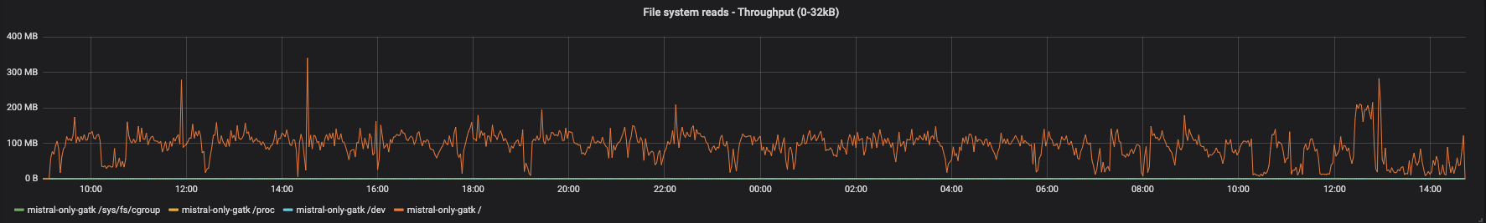
File System Reads – Throughput (0-32kB)
Nextflow
Cromwell
Native GATK

Slide 28
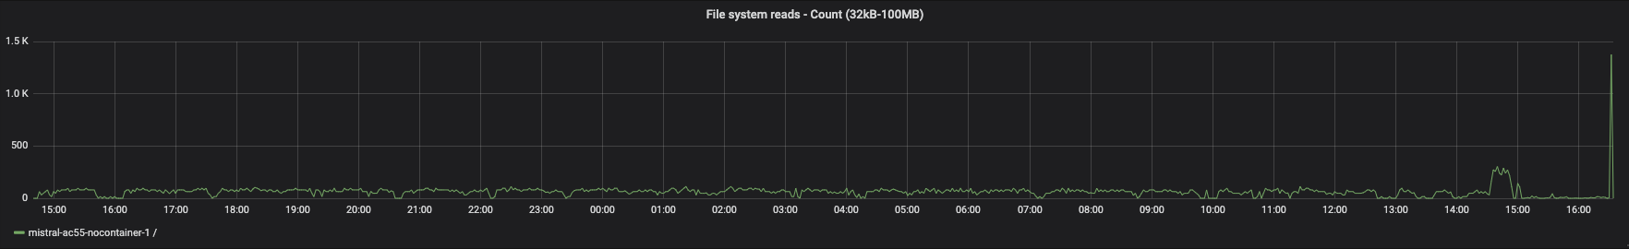
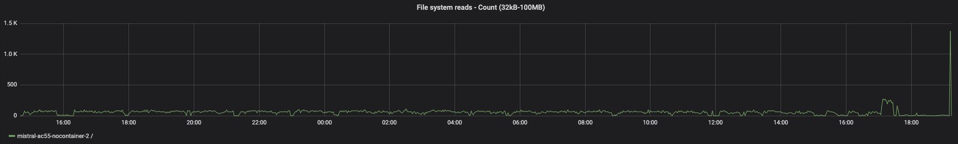

File System Reads – Count (32kB-100MB)
Nextflow
Cromwell
Native GATK

Slide 29



File System Reads – Throughput (32kB-100MB)
Nextflow
Cromwell
Native GATK

Slide 30



Mean Latency for meta data I/O
Nextflow
Cromwell
Native GATK

Slide 31



Mean Latency Writes– (0-32kB)
Nextflow
Cromwell
Native GATK

Slide 32



Mean Latency Writes– (32kB-100MB)
Nextflow
Cromwell
Native GATK

Slide 33



Mean Latency Reads– (0-32kB)
Nextflow
Cromwell
Native GATK

Slide 34



Mean Latency Reads– (32kB-100MB)
Nextflow
Cromwell
Native GATK

